Slide 1
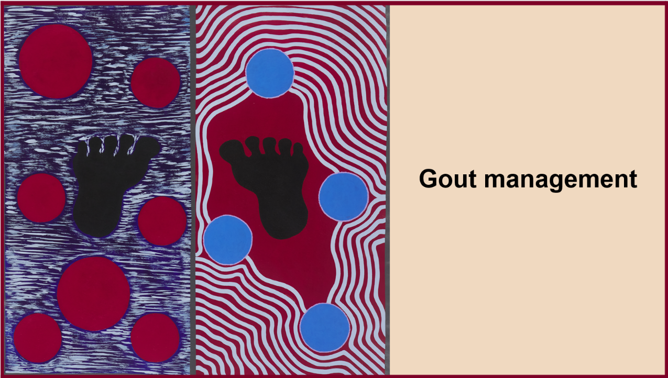
Notes:
Introduce yourself
Acknowledge that participants may have varying levels of knowledge on gout
Use simple, clear language when talking through the slides.
Encourage questions throughout rather than at the end
Emphasise that gout is manageable with proper treatment and lifestyle modifications
If you’re a health promotion worker or officer, you can use these slides:
With consumers to visually support gout education.
In collaboration with community leaders to present these slides at workshops or local events to raise awareness about gout and its management.

Slide 2
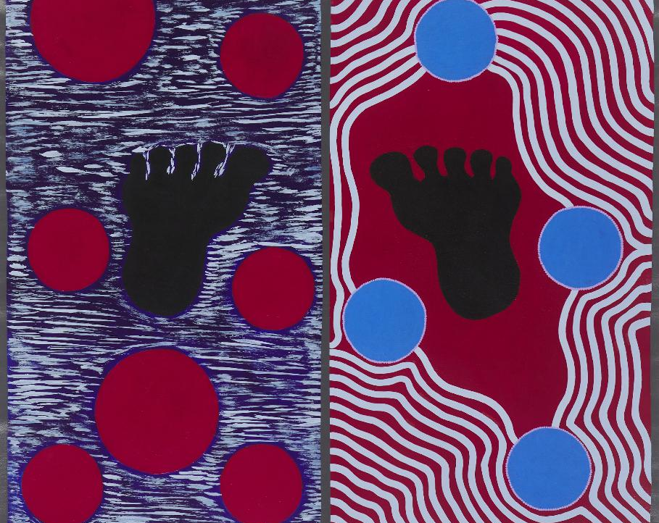
Acknowledgement of country
I would like to acknowledge the Australian Aboriginal and Torres Strait Islander peoples as the first inhabitants of the lands on which we live, learn and work.
We pay our respects to the Elders past and present and extend our respect to any First Nations people present.

Slide 3
Taking control of your gout
Workshop roadmap
1
2
3
4
UNDERSTANDING GOUT
MANAGING FLARES
TREATING GOUT
GOUT MYTHS
Recognise flare symptoms, triggers and how to treat them.
Learn effective treatment for long-term gout management.
Address common misconceptions about living with gout.
Discover what gout is, why it happens and what causes it.
Notes:
Slide provides a roadmap for the workshop
Take participants through each section of the workshop eg:
Understanding gout: Firstly, we’ll explore the basic science of gout – what happens in your body, and why.
Managing flares: Next, we’ll discuss recognising and managing painful flares.
Treating gout: Then, we’ll discuss the importance of treatment that address both active flares and prevent future flares occurring.
Gout myths: Finally, we’ll discuss some common misconceptions about gout, so you feel more confident knowing the facts about gout.
Highlight these key areas will help participants to effectively manage their gout and improve quality of life.
Tips:
Refer back to this slide throughout the presentation, when transitioning between each section.

Slide 4

Adrian's Story – Living with Gout
Watch Adrian’s story here
Notes:
Watch Adrian’s story about living with gout and how he has learned to manage it to keep doing activities he enjoys.

Slide 5

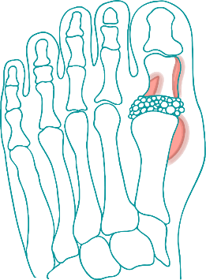






How gout affects people
Trouble moving (walking, driving, lifting)
Trouble sleeping
Increased risk of joint damage and deformity
Time off work
Increased risk of chronic kidney disease and kidney stones
Poor mental health and wellbeing
May increase the risk of heart problems
Notes:
Explain that this slide illustrates that gout is a ‘whole-of-body’ condition that has wide ranging effects on the body beyond pain.
Go through each impact of gout:
Trouble moving: Walking, driving and lifting objects can become challenging during flares. Explain that these limitations can persist between flares, if not treated.
Joint damage and deformity: Explain untreated gout can lead to joint deformity that is irreversible, but preventable with treatment.
Kidney complications: Explain that untreated gout increases the risk of kidney stones and kidney disease.
Heart disease: Explain that untreated gout may increase the risk of heart disease, and that treating gout can support heart health.
Impact on mental health: Explain that the pain and limitations of gout can contribute to poor mental health and wellbeing including depression and anxiety.
Impact on work: Discuss how flares can impact ability to go to work, potentially leading to financial strain from missed workdays.
Trouble sleeping: Discuss how pain from flares can disturb sleep, as even a sheet can cause severe pain. Discuss how poor sleep can have broader impacts on quality of life. Suggest possible solutions, like elevating affected joint during sleep.
As a closing point, emphasise that this graphic highlights the importance of proper treatment and that many of these problems can be improved/prevented with consistent care & treatment.

Slide 6
WHAT IS GOUT?
What is gout?
Gout is a common type of arthritis in adults. It is caused by high uric acid levels in the blood. This happens when:
Our bodies make too much uric acid, or
Our kidneys cannot get rid of the uric acid fast enough.
Notes:
Begin with a simple definition of gout eg “Gout is a type of arthritis caused by too much uric acid in the blood.”
Emphasise that gout is a common condition in adults.
Clarify that while gout is commonly found in the big toe it can occur in any joint.
Other suggestions:
It may help to share statistics on the prevalence of gout to highlight how common it is and help normalise the condition. Australia is the second most affected country by gout in the world after New Zealand.

Slide 7
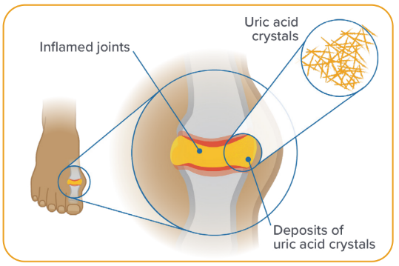
WHAT IS GOUT?
What happens?
Excess uric acid forms tiny crystals inside joints, causing swelling and pain. This is called a gout flare.
Notes:
Explain how uric acid forms into crystals inside the joints and causes inflammation and intense pain – refer to image to help visualise the crystals forming in the joints.

Slide 8





WHAT IS GOUT?
What is uric acid?
Uric acid forms when your body breaks down substances called purines. Purines are found in our bodies, and in some of the foods we eat.
Notes:
Explain that uric acid forms when our body breaks down purines, which are substances found in our bodies and in some of things we eat and drink.

Slide 9
GOUT CAUSES
What causes gout?
Gout is caused by high uric acid levels. This is mostly due to genetics. Many people with gout have inherited it from a family member.
Notes:
Explain that gout is caused by having high uric acid levels, which is mostly due to genetics.
Emphasise that gout is not a result of poor diet

Slide 10
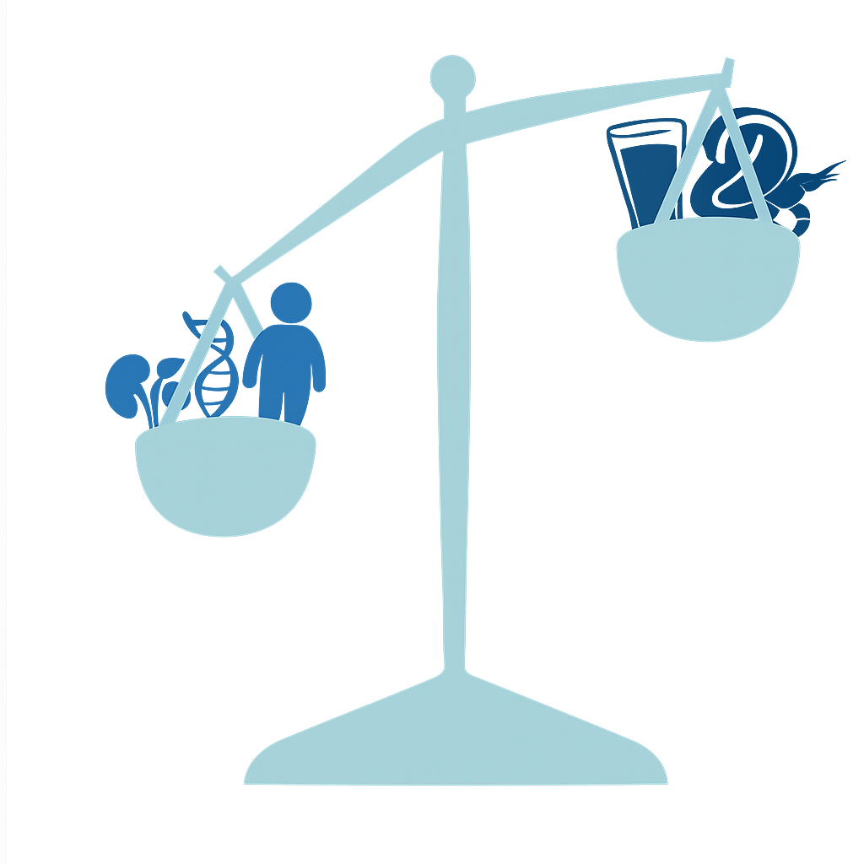
GOUT CAUSES
Kidney disease
Being overweight or obese
High cholesterol, high blood pressure or type 2 diabetes
Taking diuretic medicines (these help you to produce more urine)
Food
Drink
Genetics
Heart disease
Obesity
Notes:
Discuss the other gout risk factors – refer to image illustrating that genetics and other conditions are more likely to cause gout than diet.

Slide 11

RECOGNISING FLARES
A flare is the first sign of gout
Flare symptoms include:
Sudden, intense pain in one or more joints
Swelling (inflammation) around the sore joint/s
Redness, heat and tenderness in one or more joints
Finding it hard to walk or move the joint.
Without treatment a gout flare lasts up to 2 weeks
Notes:
Acknowledge that many participants have likely experienced these symptoms and may be concerned about potential future flare-ups.
Clarify for participants that haven’t been diagnosed, that recognising these symptoms is the first step to a definitive diagnosis, which will require your GP to do some tests and examine you to confirm you have gout.
A flare is the first sign of gout – highlight that many people have high uric acid levels for years before having their first flare. The onset of these symptoms may confuse some people, who mistake it for an injury or something else. Gout flares are very sudden and happen over a few hours or overnight.
Talk through the symptoms eg:
Often the joint is extremely sore to touch and can be painful to walk. Some people describe the pain as walking on glass.
The build-up of the joints can cause visible swelling, making the joint look puffy or enlarged.
The joint may appear red, warm and sore to touch.
Walking or doing daily activities may become difficult during a flare.
Without treatment, a gout flare usually lasts up to 2 weeks
Other suggestions:
- Ask participants the symptoms most noticeable to them to encourage shared experiences and reinforce the information.

Slide 12
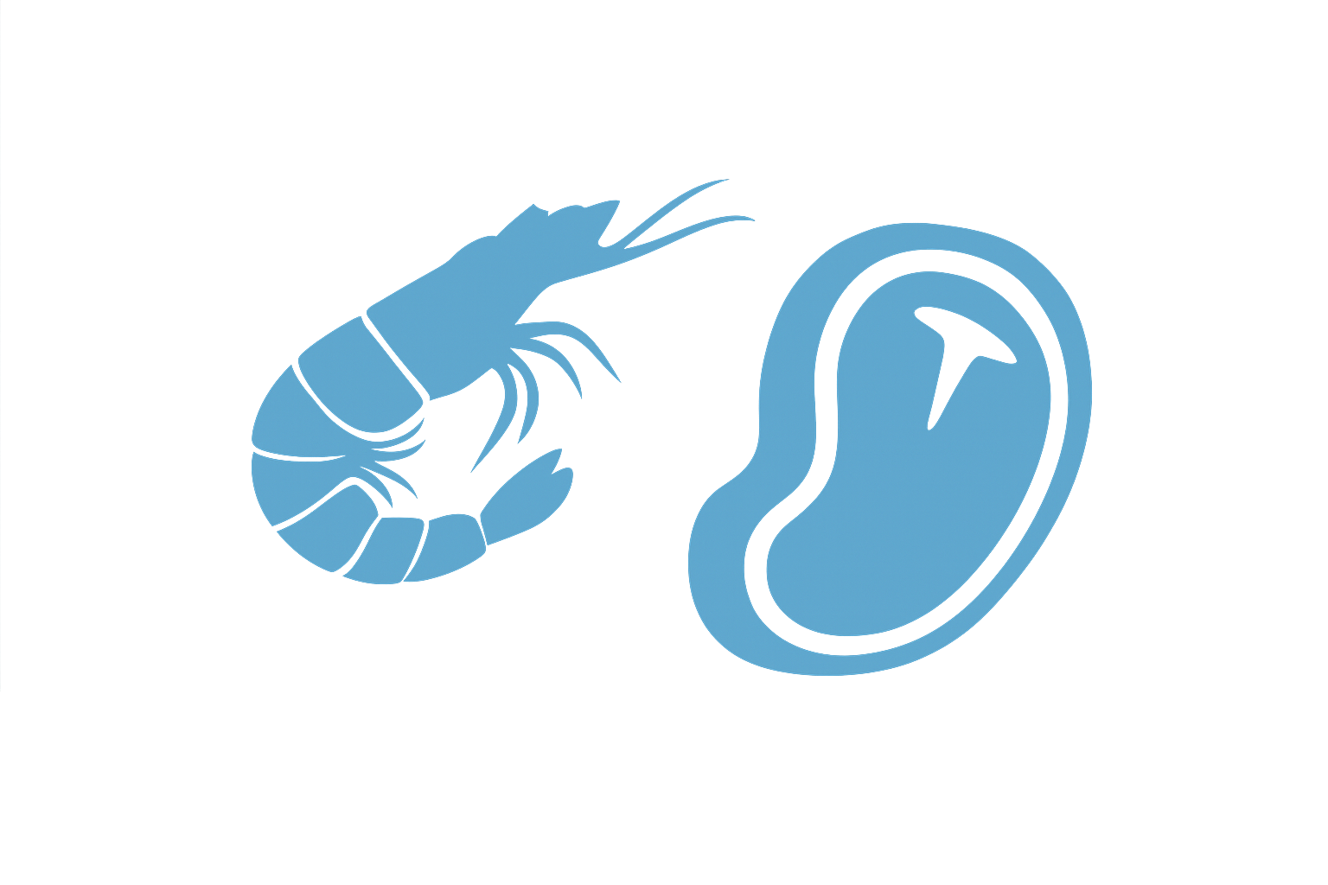





MANAGING FLARES – RISK FACTORS
Watch for these triggers
Eating foods high in purines
Drinking sugary soft drinks or fruit juice
Drinking alcohol
Not drinking enough water
Rapid weight loss
Injury or trauma to the joint
These are triggers that may increase your uric acid levels and cause a gout flare
Notes:
Explain that these triggers can increase uric acid levels and crystal formation in the joints risking a flare.
Clarify that these triggers may not affect everyone.
Breakdown each individual risk factors:
Foods high in purines: Foods high in purines, like red meat and seafood can increase uric acid levels when eaten in large amounts.
Non-diet soft drinks/fruit juice: these types of drinks have high fructose (sugar) content, which can increase uric acid levels.
Alcohol: raises uric acid levels while slower the kidneys' ability to remove uric acid from the body.
Dehydration: Not drinking enough water makes it harder for your kidneys to remove uric acid from the blood.
Rapid weight loss: Clarify this means crash dieting and fasting. Explain that when the body loses weight quickly, it releases more uric acid. Emphasise that gradual weight loss is recommended and that maintaining a healthy weight long-term reduces gout risk.
Injury or trauma to the joint: physical trauma can trigger crystal formation in the affected joint.
Emphasise that knowing your triggers can help to prevent future flares.
Other suggestions:
Encourage participants to identify their own triggers.

Slide 13
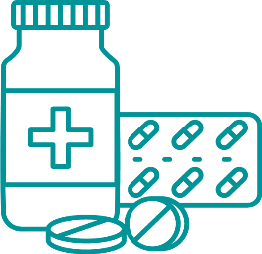
TREATING FLARES
How to treat a flare
It is important to treat a gout flare as soon you notice the first signs.
Your doctor will give you flare medicines to lower joint pain and swelling.
These medicines will help a current flare but will not stop new flares.
To stop more flares, you will need to take daily medicines to lower your uric acid levels.
Notes:
Emphasise the importance of treating a gout flare as soon as you first notice the signs
Emphasise that medication is necessary to reduce the severity (pain and inflammation) and length of the flare.
Can discuss specific medications (NSAIDs, colchicine, corticosteroids) with participants.
Emphasise that these medicines will not stop flares from happening in the future – highlighting that these medicines will relieve the immediate symptoms of gout a flare but not treat the underlying condition.
Address any concerns or barriers participants may have about taking medicines.

Slide 14
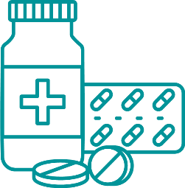

TREATING GOUT
How to stop future flares
There are medicines that lower uric acid levels in the blood.
These medicines are known as urate-lowering therapies (ULT).
Taking these medicines is the best way to treat gout and stop more flares.
Notes:
Emphasise that taking medicines to lower uric acid levels is the best way to stop gout flares in the future.
Explain the difference between uric-acid lowering medicines, used-for long-term management and pain relief medicines, which are taken during gout flares.
Encourage participants to download the gout care plan via the QR code to help them keep track of their medicines and track their uric acid levels.

Slide 15
TREATING GOUT
How to take these medicines
Most people will take a medicine called allopurinol
These medicines need to be taken each day even if you are not having a flare.
Make sure to talk with your doctor or Aboriginal health worker about any bush medicines or other remedies you're using, so they can work together safely with your prescribed treatment.
Notes:
Explain that allopurinol is the most common and long-established medicine for gout, and it is generally considered safe.
Explain that these types of medicines are taken everyday, not just when a flare happens.
Encourage people to share if they use other types of medicine, including bush medicines
Reinforce that is ok to use bush medicine and that it is important their healthcare team knows to ensure it works safely with their prescribed medicine.

Slide 16

Remember
Treating a flare
Medicines that relieve pain and swelling fast.
Preventing flares
Medicines that lower uric acid and help keep flares away
Notes:
Reinforce the difference between treating a gout flare and treating gout to prevent future flares.

Slide 17
TREATING GOUT
Reaching your target uric acid level
The doctor will check your uric acid level regularly.
Your medicine dose might be changed to help you reach your target level.
The target level will help reduce future gout flares.
Notes:
Explain that the doctor will check your uric acid levels until your target level is reached.
Address any potential questions or concerns.

Slide 18
TREATING GOUT
Urate-lowering therapy roadmap
1.
2.
3.
4.
The doctor will start you with a low dose
The doctor will check your uric acid levels with a blood test
The doctor will increase your dose
Repeat this process until you reach your target level
Notes:
Explain that this is image is a step-by-step approach to managing gout using urate-lowering therapy.
Talk through each step:
Step 1 Starting a low dose: The doctor will begin treatment with a low dose of ULT to reduce the risks of side-effects and flares. Explain that the body may need to time to adjust and it is common to see flares during this time.
Step 2 tracking levels: The doctor will regularly monitor uric acid levels through blood tests.
Step 3 adjust dose: The doctor will gradually increase the dose based on test results to move closer to the target uric acid level. Explain that individual targets levels will depend on the severity of gout.
Step 4 Repeat until target reached: The doctor will continue to monitor and adjust doses until the target uric acid level is reached.
Explain that this process can take a few months, and that it is important to continue taking the medicine, even when you feel good.
Address any questions or concerns.

Slide 19









TREATING GOUT
How can I look after my gout
Drink less sugary soft drinks and fruit juices.
Maintain
a healthy
weight
Foods high in purines include:
Bacon Anchovies
Beef Mussels
Turkey Scallops
Kangaroo Sardines
Rabbit Prawns
Drink less alcohol. No more than 2 drinks per day.
Eat and drink low-fat dairy products
Drink lots of water
Notes:
Explain that food and lifestyle changes can help lower the risk of a gout flare.
Acknowledge that making changes can be challenging and emphasise that small changes can make a big difference.
Breakdown each individual action:
Maintain a healthy weight: even losing a small amount of weight can help reduce gout flares. The best way to lost weight is through slow and steady weight loss, focusing on regular, balanced meals.
Staying hydrated: Drinking water can lower uric acid levels in the blood.
Limit alcohol intake: alcohol can increase risk of flares, especially beer and spirits which have high amounts of purines. Try having alcohol-free days during the week.
Low-fat dairy products: low-fat dairy foods, like milk and yoghurt can help reduce uric acid levels.
High-purine foods: Some types of foods can increase uric acid levels in the body. Trying eating these types of foods less often, rather than cutting them out completely.
Emphasise that medicine is still the most important treatment.
Address any questions, concerns or barriers.
Other suggestions: Encourage participants to identify what challenges they might face with these changes?

Slide 20

GOUT MYTHS
MYTH
MYTH
Medicine won’t help my gout.
Once my flare has gone, I no longer have gout and can stop taking medicine.
FACT
FACT
Taking medicines is the best way to treat gout and stop flares.
You still have gout even without symptoms. Medicines to lower uric acid is the best way to stop flares.
Notes:
Acknowledge these many myths about gout are common and understandable.
Go through each myth and encourage participants to discuss:
If they have heard of any of these myths before
If they were surprised by any of these myths
If they have any questions.
Reinforce key messages:
Gout is not your fault - it’s a condition you inherited.
Ongoing treatment is best to stop flares happening.
Diet and lifestyle changes are important but usually needs to be combined with medicine.

Slide 21
GOUT MYTHS
MYTH
MYTH
Drinking alcohol is why people get gout.
I can control gout with diet changes alone. ​
FACT
FACT
People who do not drink alcohol still get gout. Alcohol can trigger a flare if you have gout, but it doesn’t cause it.
Diet alone cannot control gout. Most people will still have to take medicines to control their gout and prevent future flares.

Slide 22
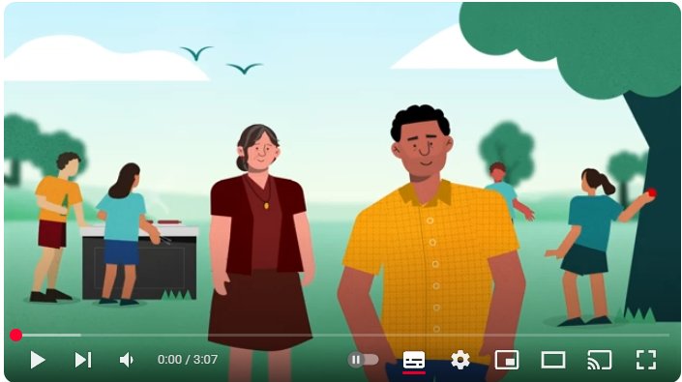
ADDITIONAL RESOURCES
Click here to learn more about gout through this short animation.
Notes:
This short video can explain gout in a simple, visual way. It’s a good reminder of what has been discussed today.
It can be helpful to watch this animation with family so they can understand more about gout.
After watching the video, ask the participant(s) if they have any questions about gout.

Slide 23
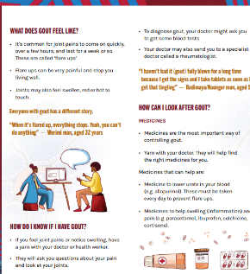

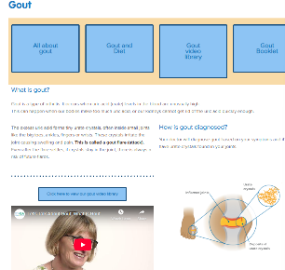
ADDITIONAL RESOURCES
Staying Moving, Staying Strong
is a website created to help Aboriginal and Torres Strait Islander peoples, their families and communities to understand more about different types of arthritis including gout.
https://www.stayingstrongwitharthritis.org.au/
Arthritis Australia Gout Hub
offers a wide-range of education and support tools to understand and manage gout.
https://arthritisaustralia.com.au/gout

Slide 24

Arthritis Australia would like to thank Adrian for generously sharing his experience of living with gout.
Notes:
Closing slide

